Slide 1

Lee Ratcliff
Competency Portfolio
www.infratec-uk.com

Slide 2
Competency Summary
Category | Accreditation Body | No. | Expiry
Lorry Loader – Capacity up to: Unlimited Categories: D1+E | ALLMI | 257602 | 11/10/2028
Emergency First Aid at Work | Qualsafe Awards | 3688506 | 27/06/2028
Working at Height Level 2 (RQF) | Qualsafe Awards | 3021026 | 15/02/2026
Highways Electrical Registration Scheme (HERS) | HEA | HO163381 | 04/12/2027
National Highways Safety Passport | National Highways | 14-00013923 | 04/05/2027
IPAF (3A & 3B) | IPAF | OP/2243041 | 31/10/2027
IPAF (1B) | IPAF | OP/2191581 | 31/07/2027
CPCS Appointed Person | CSCS | 040596574 | 31/05/2027
CPCS Slinger / Signaller (All Types) | CSCS | 040596574 | 31/05/2027
CPCS Crane / Lifting operations supervisor | CSCS | 040596574 | 31/05/2027
www.infratec-uk.com

Slide 3
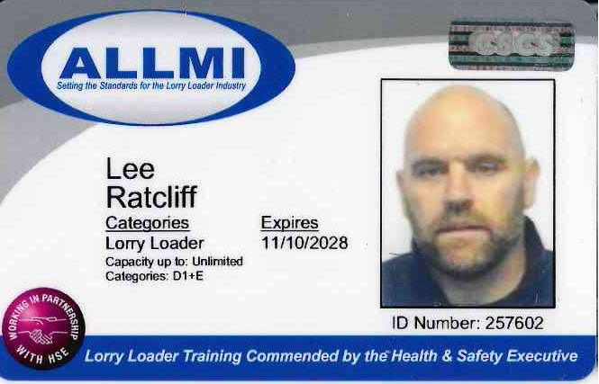
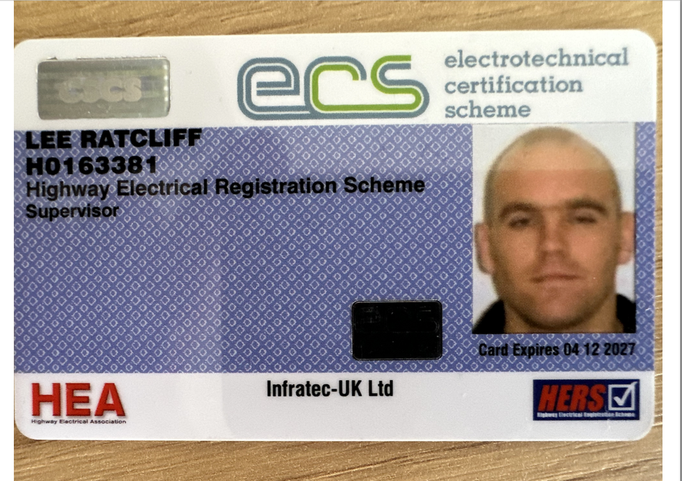
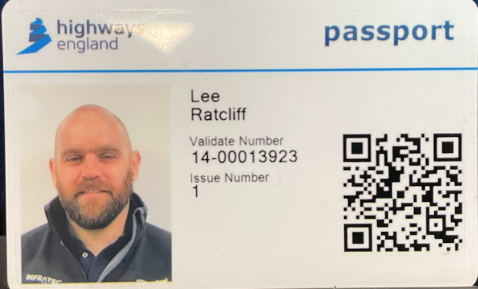

Competency Cards
ECS
National Highways Safety Passport
ALLMI
www.infratec-uk.com

Slide 4
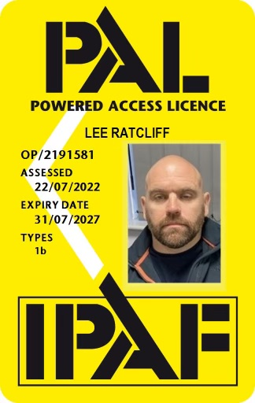
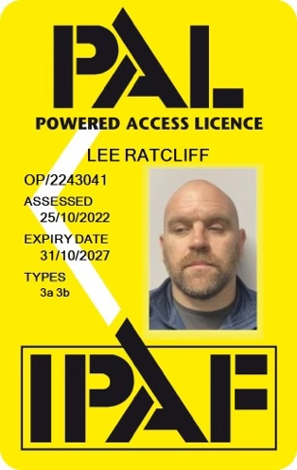
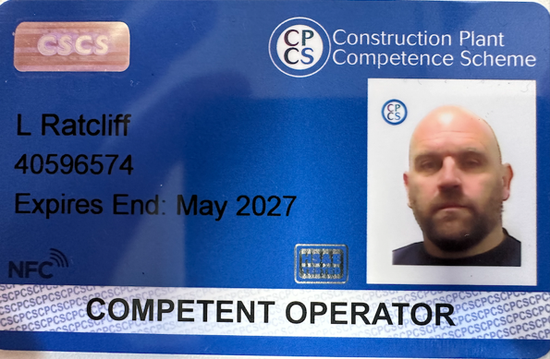
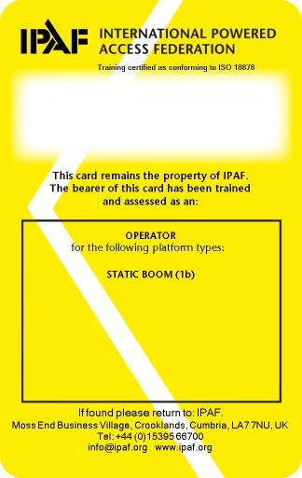

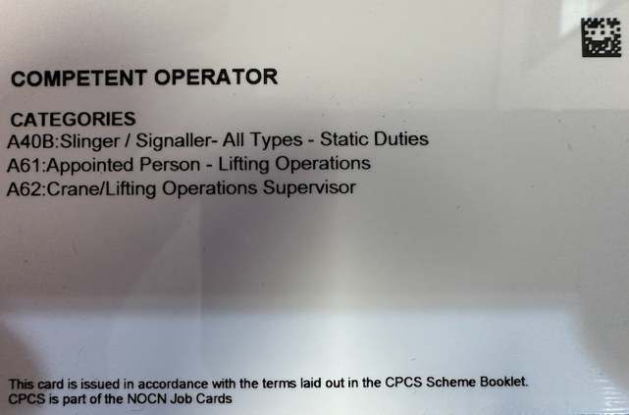
Competency Cards (cont.)
IPAF
IPAF
CSCS
www.infratec-uk.com

Slide 5
Additional Training
Other Training
City & Guilds Level 3 Certificate, Electrical Installations (BS7671 2008), EAS Training Ltd, 16 October 2009.
City & Guilds Level 3 Certificate, Inspection, Testing and Certification of Electrical Installations, EAS Training Ltd, 25 January 2010.
IOSH Managing Safely, INFRATEC Training, 16 October 2019. Certificate No 692431
www.infratec-uk.com

